Slide 1
RULES OF ORIGIN (Workshop)
For Rule A – Wholly procured
100 Mexican born calves were sent to a farm in Arizona that fed and raised them into fully-grown and matured cows. The farm then exported 50 cows to Kobe, Japan. A Japanese exporter after fattening them exported 25 cows to Taiwan.
What is the country of origin of the 50 cows exported to Japan? Why?
What is the country of origin of the 25 fattened cows exported to Taiwan? Why?
Answer: Mexico because the cows were born there.
Answer: Mexico because the cows were born in Mexico and even if they grew up, lived and were fattened in another country, its origin will always be where they were born.

Slide 2
RULES OF ORIGIN (Workshop revisited)
For Rule A – Wholly procured
100 Mexican born calves were sent to a farm in Arizona that fed and raised them into fully-grown and matured cows. The farm exported 50 cows to Kobe, Japan out of which beef filets for steaks were made. Out of the remaining 50 cows the US farm decided to make beef shanks and ribs to re-export back to Mexico that repackaged them and sold them to France.
What is the country of origin of the beef filets? Why?
What is the country of origin of the beef shanks and ribs that France imported? Why?
Answer 1: Japan because the the cows were transformed into pieces of meat (beef filets) in Japan.
Answer 2: USA because the the cows were transformed into shanks and ribs in Arizona.

Slide 3
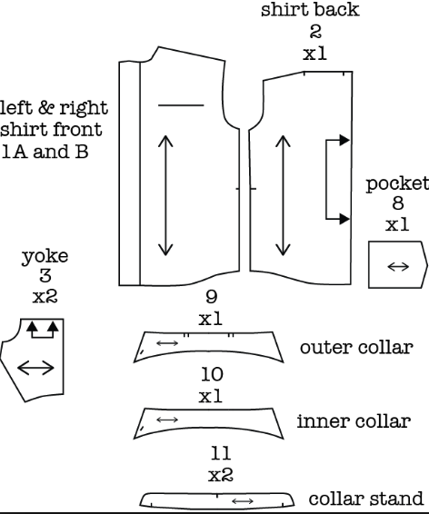
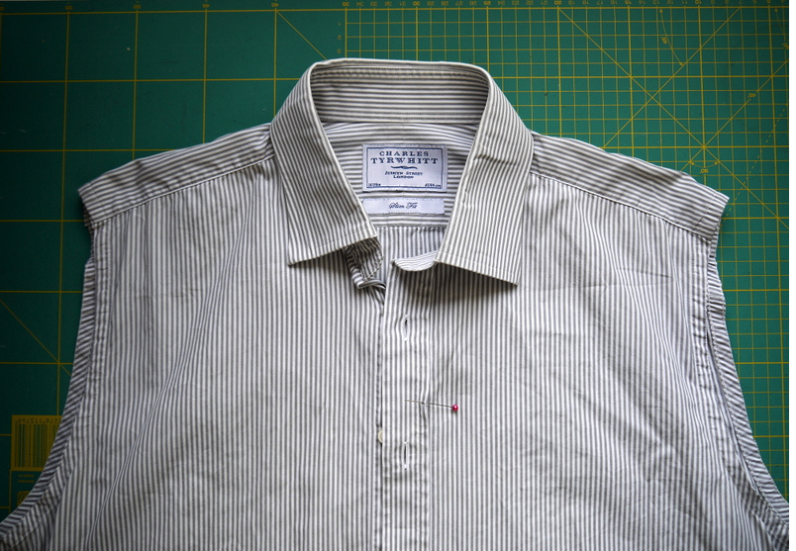
RULES OF ORIGIN (Workshop)
For Rule B – Tariff Shift
Cotton textile material from China was imported by a Bangkok importer that cut the woven material into shapes to make a ladies shirt.
The cut shapes were then exported to Vietnam to be stitched together.
The stitched but unfinished shirts were sent to Laos so that the collars could be put on, the buttons affixed, ironed, folded and packed into sleeves for export to Germany.
What is the country of origin of the shirts? Why?
Answer: Vietnam because the shirts were wholly assembled with its major components in Vietnam.

Slide 4
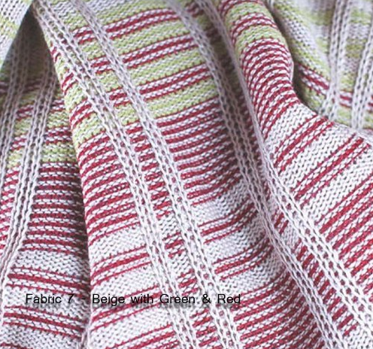
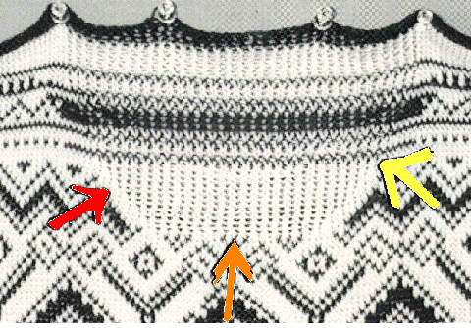
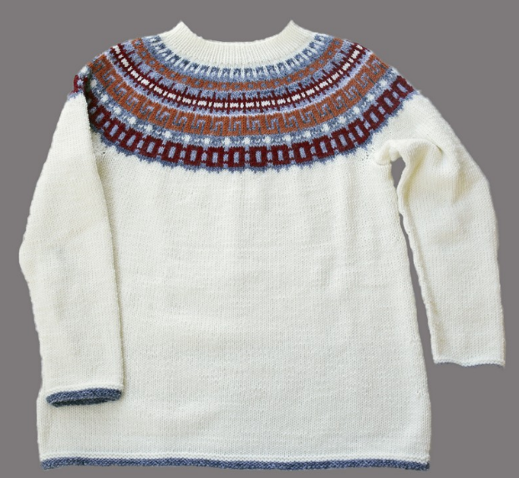
RULES OF ORIGIN (Workshop)
For Rule B – Tariff Shift
body
Cotton textile material from China was imported by a Thai importer that knitted the material into shapes to make a ladies sweater.
sleeves
The shapes were then exported to Vietnam to be stitched together.
The stitched but unfinished sweaters were sent to Laos so that the collars could be put on, the zippers affixed, folded and packed for export to Germany.
What is the country of origin of the sweaters? Why?
Answer: Thailand because the sweaters were knit to shape in the US.

Slide 5
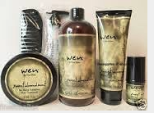
Indicate the tariff treatment of the following imported items in sets or kits:
Tool kit
Medical kit
Beauty kit

Slide 6
Indicate the tariff treatment of the following containers presented with their contents:
1. Decorated metal cookie tin with cookies
2. Sturdy plastic boat filled with candy

Slide 7
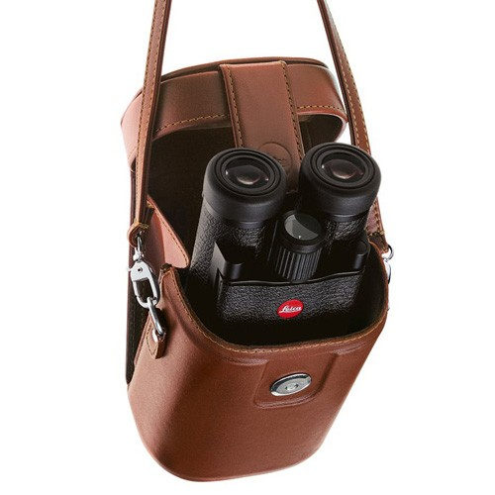
Indicate the tariff treatment of the following containers presented with their contents:
3. Binocular case
4. Crystal decanter filled with brandy

Slide 8
Would the following be considered complete under classification rules?
An assembled fork-lift truck without a seat
A disassembled fork-lift truck without a seat
A battery charger without its cables
A motor vehicle without an engine
An assembled mechanical watch without hands
An unassembled bicycle with all its parts

Slide 9
Dates and Places
WORKSHOP
A shipment is sold from a Laotian company to an importer in Frankfurt, Germany. The shipment leaves the Lao seller’s place of business in Luang Prabang on January 7th and crosses the border into Thailand on January 8th. It goes to the port of Bangkok, Thailand, where it is loaded aboard a ship for Germany. The ship sails from Bangkok, Thailand on January 15th, develops a leak and stalls in the Gulf of Thailand. It is then towed to Singapore where all its cargo is loaded onto another vessel on January 18th. It sets sail for the port of Bremen in Germany on January 19th. The ship arrives in Bremen on February 9th. The shipment is unloaded and put onto a truck on February 10th and arrives at the importer’s premises in Frankfurt on February 11th.
What is the date of export?
What is the date of import?
What is the port of export?
What is the port of import?
January 8th
February 9th
Bangkok
Bremen

